Slide 1
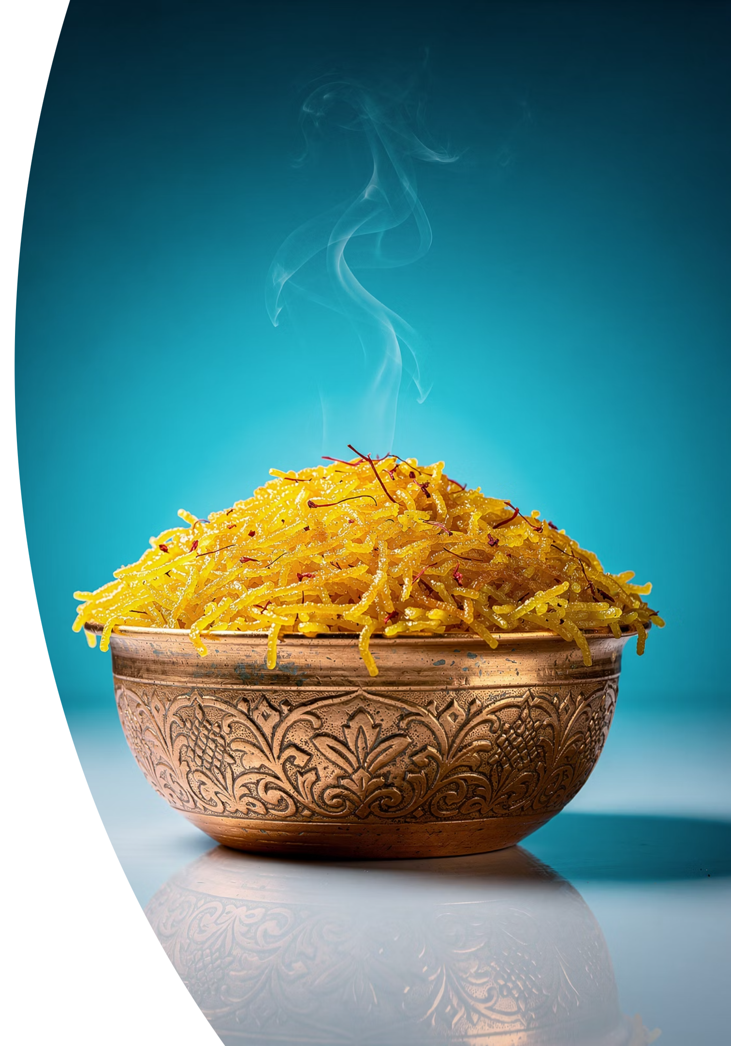
Darius: The Persian Crunch
Crispy Persian Heritage. Global Fusion.
From the empire of Darius the Great — who unified the ancient world through vision, innovation, and cultural mastery — comes a new culinary reign. Darius: The Persian Crunch brings the art of tahdig, Persia's most beloved crispy rice tradition, to the streets of Beverly Hills. Fully customizable. Boldly global. Unmistakably Persian.
"Choose your tahdig. Rule your plate."

Slide 2


THE OPPORTUNITY
A Royal Market Hiding in Plain Sight
Beverly Hills sits at the intersection of extreme affluence and extraordinary cultural diversity. With a median household income exceeding $150,000 and one of the highest concentrations of Iranian-American residents in the nation — locally known as Tehrangeles — the demand for premium, authentic Persian cuisine has never been stronger or less served at street level.
700K+
25%
Persian-Americans in LA
Beverly Hills Iranian Residents
The greater Los Angeles Persian community numbers over 700,000, with Beverly Hills alone housing an estimated 20–25% Iranian-American population. These are customers who know tahdig, love it deeply, and have waited decades for someone to serve it with the premium experience it deserves.
$150K+
$18B
Median Household Income
LA Food Truck Market
The gap is clear: traditional Persian food exists in sit-down restaurants — but no one has elevated it to a premium, Instagram-worthy, customizable street food experience. Until now.

Slide 3
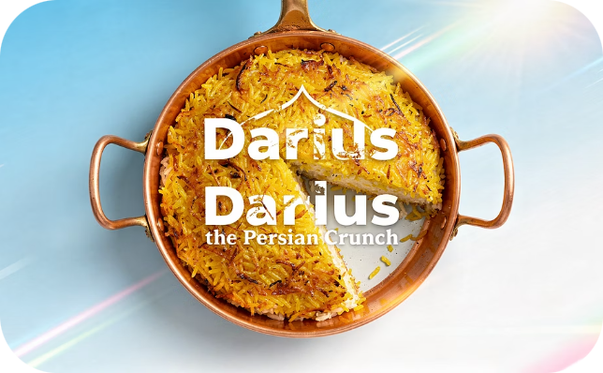
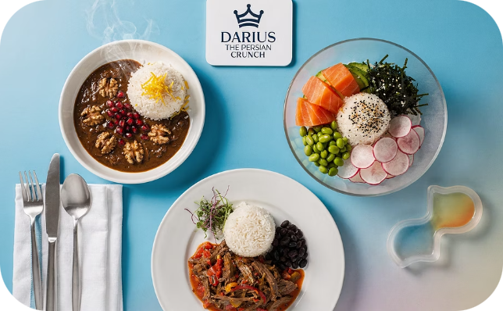
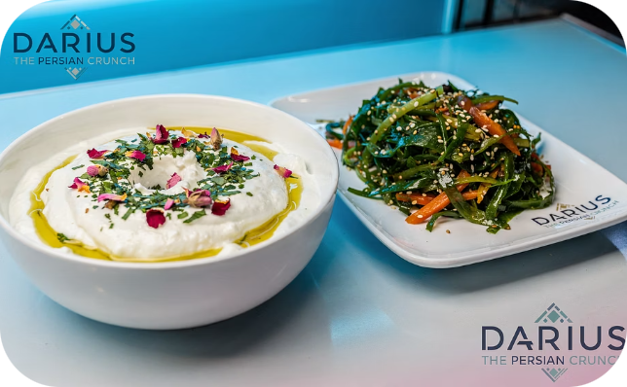
THE EXPERIENCE
Build Your Reign — Three Steps to Perfection
Every order is a canvas. Guests choose their crispy tahdig base, select a globally-inspired protein, and finish with a signature side — creating a meal that is entirely their own. Premium ingredients, intentional pairings, and a price point that reflects the craft: $17–$26 per build-your-own bowl.
Step 1 — Choose Your Base
Step 2 — Choose Your Protein
Step 3 — Choose Your Side
Crispy Rice Tahdig — the classic, golden and crackling
Crispy Bread Tahdig — lavash-lined, smoky and rich
Crispy Potato Tahdig — hearty, caramelized, deeply savory
Crispy Tofu — vegan, glazed in saffron citrus
Ropa Vieja — slow-braised Cuban-Persian fusion
Sashimi / Poke — luxury oceanic freshness
Fesenjoon Stew — pomegranate walnut, deeply Persian
Persian Yogurt — cooling, herb-flecked, house-made
Seaweed Salad — umami-bright, a nod to global fusion
Average ticket: ~$21

Slide 4

BUSINESS MODEL
Revenue, Reach & Traction Plan
Three Revenue Streams
12-Month Scenario Planning
🚚 Daily Truck Sales
Scenario
Daily Revenue
Annual Revenue
Prime Beverly Hills locations — Rodeo Drive corridor, Century City, and high-traffic lunch corridors. Target 80–120 covers per day at ~$21 average.
Conservative
$1,200
~$350,000
Base Case
$1,700
~$430,000
Optimistic
$2,200
~$500,000+
🥂 Catering & Private Events
High-margin catering for Persian weddings, corporate lunches, and entertainment industry events. Beverly Hills is catering gold.
Catering events add $800–$3,000 per booking at 60–70% margin — the highest-value revenue channel in the model.
📱 Social Media & Virality
Crispy tahdig ASMR videos are proven viral content. Built-in shareability drives organic reach to Persian-American communities nationwide and foodie audiences globally.

Slide 5
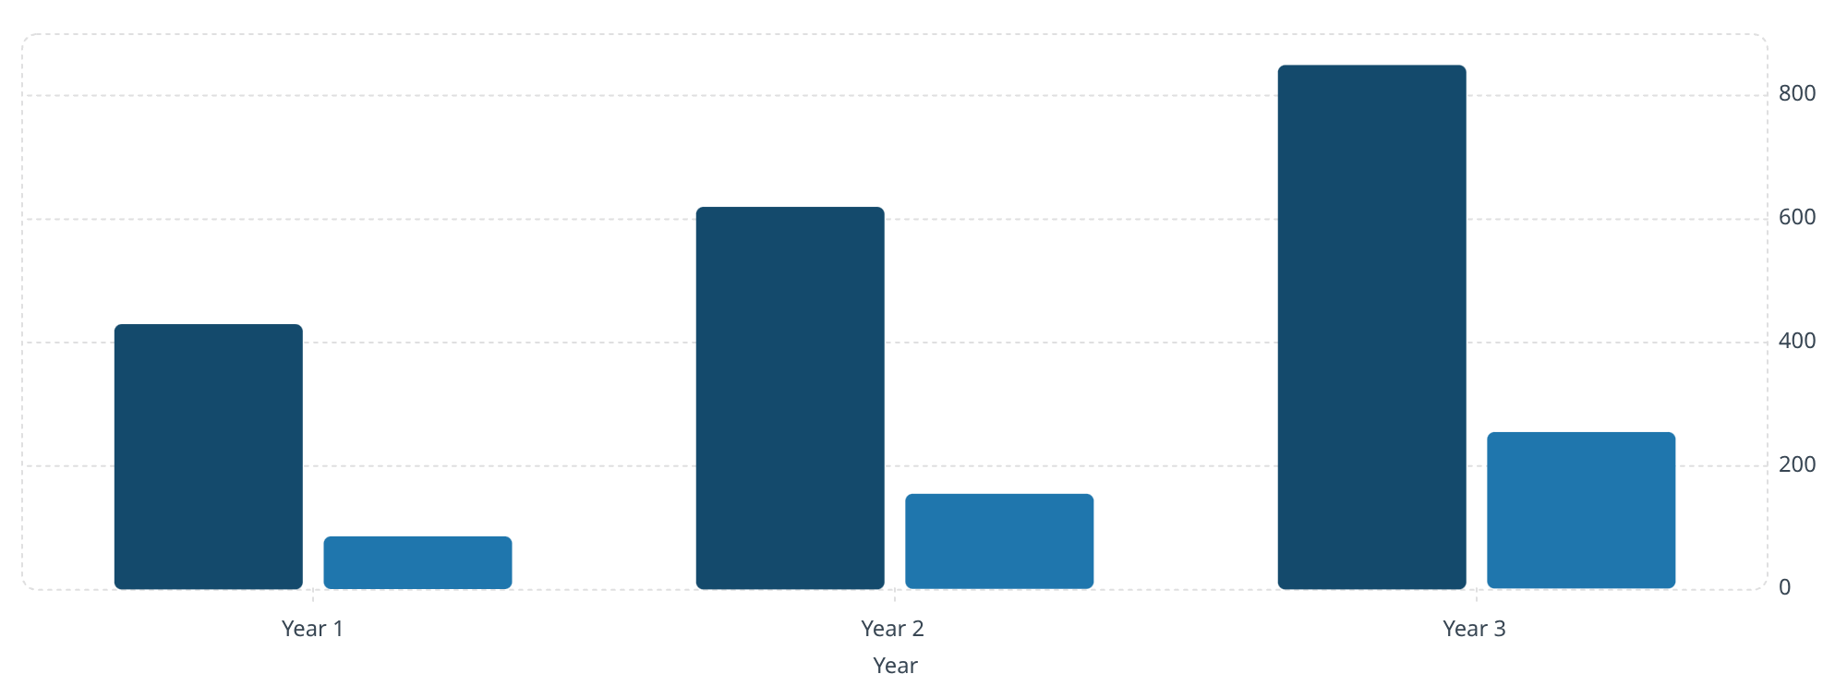
FINANCIALS & ASK
The Numbers Behind the Empire
Revenue ($K)
Net Profit ($K)
Key Financial Metrics
850
Food Cost %
28–32% of revenue — premium ingredients, disciplined portioning
620
430
Gross Margin
255
~68–72% — industry-leading for street food at this price point
155
86
Break-Even
Projected at Month 7 under base-case scenario
Modeled at base-case daily sales with two catering events per month. Year 2 reflects a second truck deployment. Year 3 assumes a ghost kitchen licensing agreement and expanded catering fleet.
The Ask
$150,000 for truck build-out, initial inventory, branding, licensing, and a 90-day marketing launch campaign — in exchange for 15% equity or structured as a convertible note.
"Join the next chapter of Persian culinary empire-building. The tahdig is golden. The timing is now."

